Slide 1
Lecture 14
Continuous Time Markov Chains

Slide 2
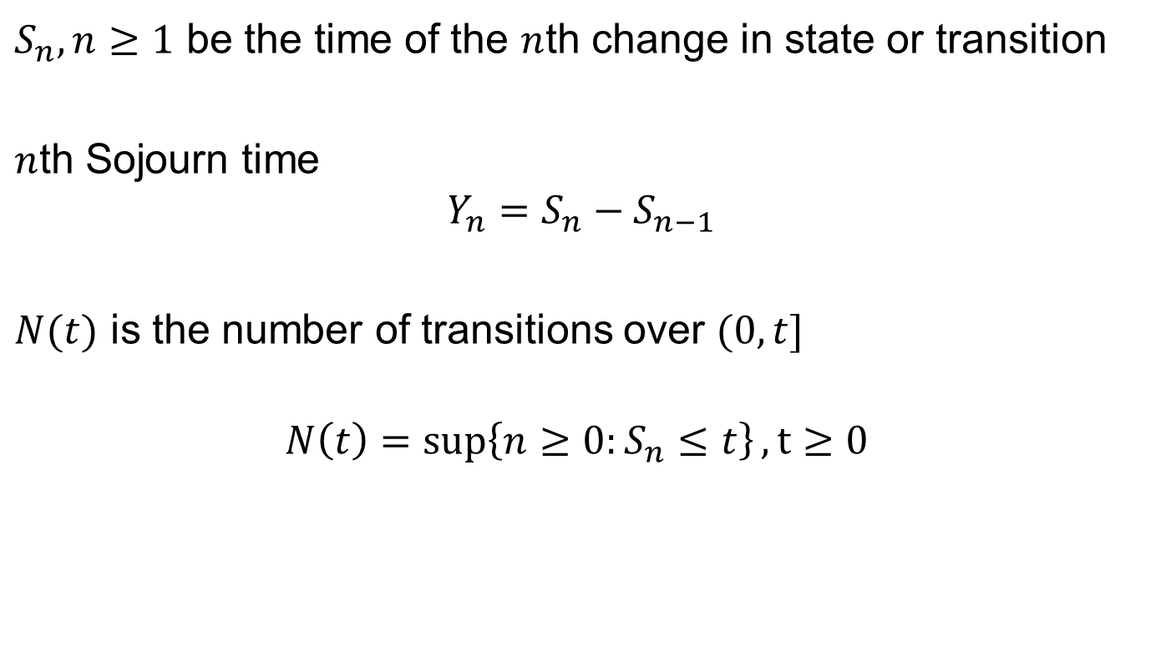
Sojourn Time and Transitions
$S_{n},n≥1$ be the time of the $n$th change in state or transition
$n$th Sojourn time
$$Y_{n}=S_{n}−S_{n−1}$$
$N(t)$ is the number of transitions over $(0,t]$
$$N\left(t\right)=\sup\left\{n≥0:S_{n}≤t\right\}, t≥0$$

Slide 3
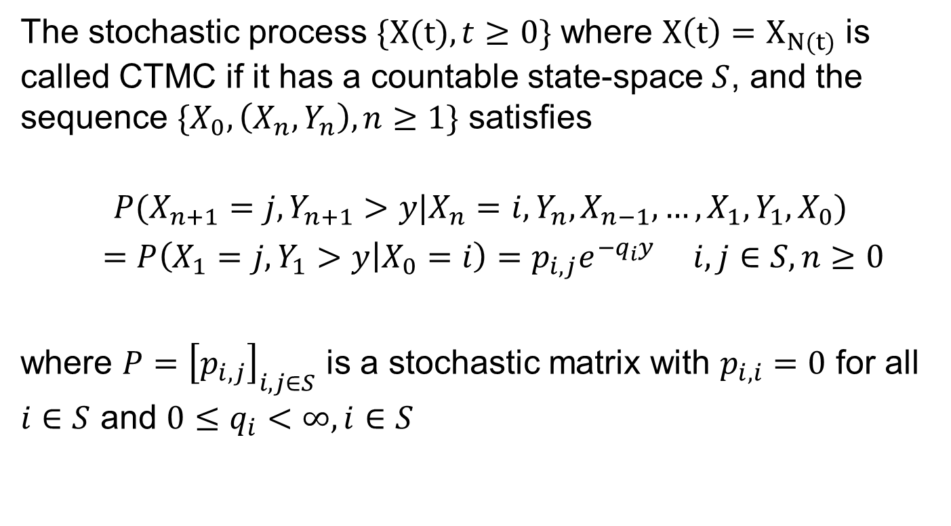
Continuous Time Markov Chain
The stochastic process $\{X(t), t≥0\}$ where $X\left(t\right)=X_{N(t)}$ is called CTMC if it has a countable state-space $S$, and the sequence $\{X_{0}, \left(X_{n},Y_{n}\right), n≥1\}$ satisfies
$$P(X_{n+1}=j,Y_{n+1}>y|X_{n}=i, Y_{n},X_{n−1},…,X_{1},Y_{1},X_{0})$$
$=P\left(X_{1}=j,Y_{1}>y | X_{0}=i\right)=p_{i,j}e^{−q_{i}y} i,j∈S, n≥0$
where $P={\left[p_{i,j}\right]}_{i,j∈S}$ is a stochastic matrix with $p_{i,i}=0$ for all $i∈S$ and $0≤q_{i}<∞, i∈S$

Slide 4
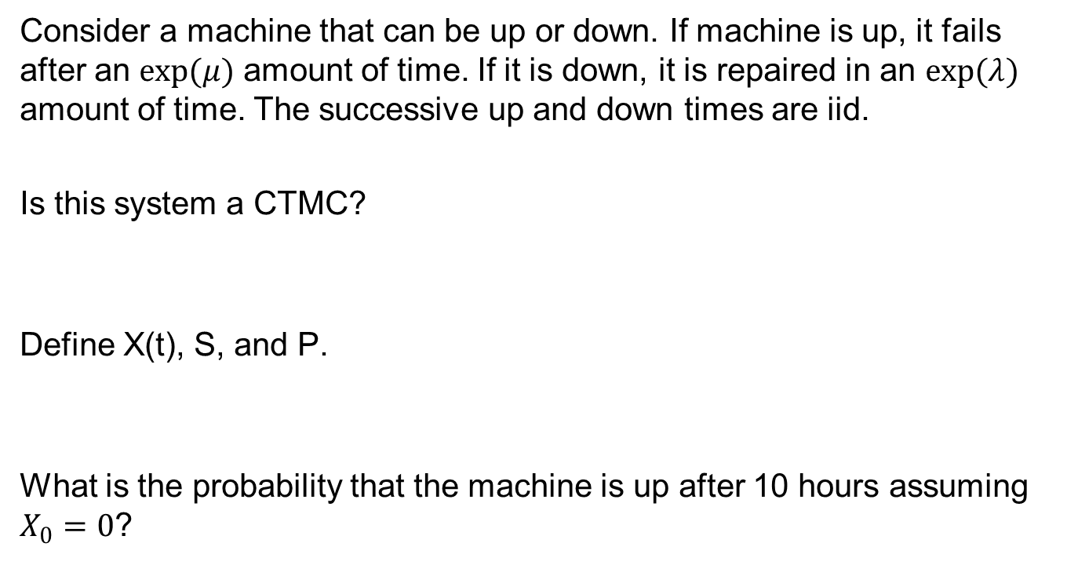
Example
Consider a machine that can be up or down. If machine is up, it fails after an $exp(μ)$ amount of time. If it is down, it is repaired in an $exp(λ)$ amount of time. The successive up and down times are iid.
Is this system a CTMC?
Define X(t), S, and P.
What is the probability that the machine is up after 10 hours assuming $X_{0}=0$?

Slide 5
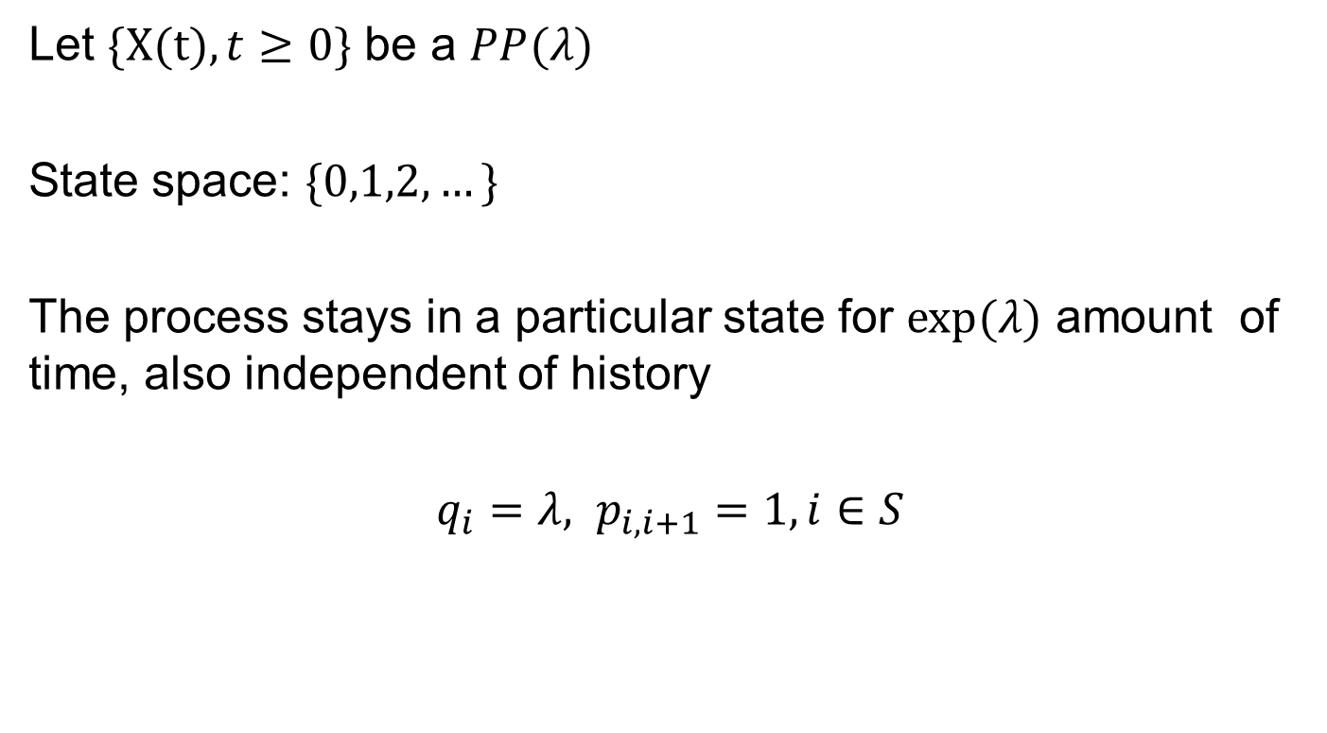
Poisson Process as CTMC
Let $\{X(t), t≥0\}$ be a $PP(λ)$
State space: $\{0,1,2,…\}$
The process stays in a particular state for $exp⁡(λ)$ amount of time, also independent of history
$q_{i}=λ, p_{i,i+1}=1, i∈S$

Slide 6
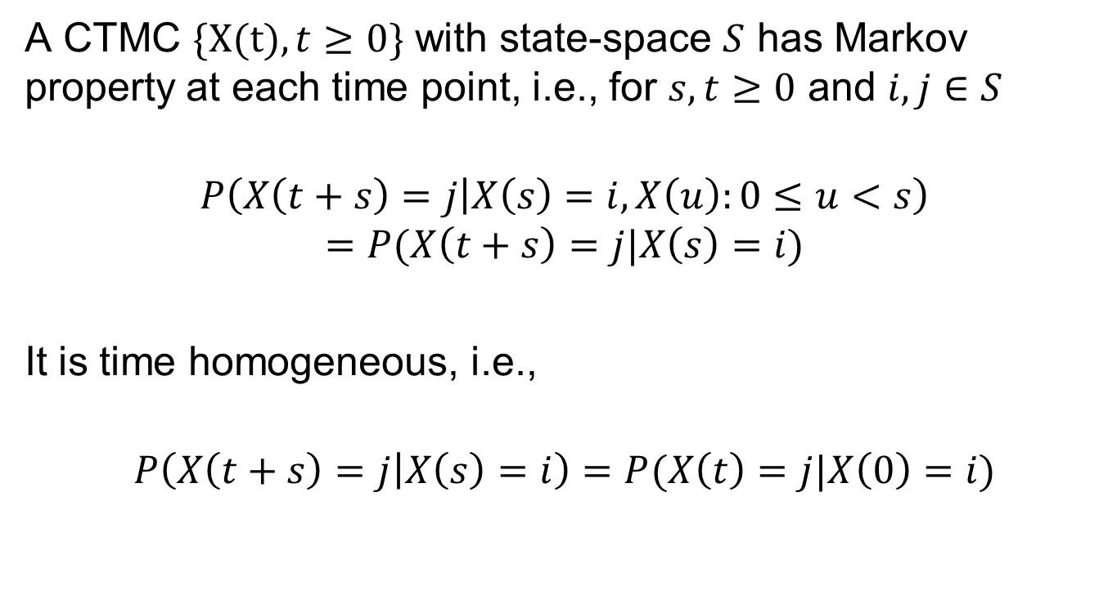
Markov Property
A CTMC $\{X(t), t≥0\}$ with state-space $S$ has Markov property at each time point, i.e., for $s,t≥0$ and $i,j∈S$
$$P\left(X\left(t+s\right)=j | X\left(s\right)=i, X\left(u\right):0≤u<s\right)$$
$$=P(X\left(t+s\right)=j|X\left(s\right)=i)$$
It is time homogeneous, i.e.,
$$P\left(X\left(t+s\right)=j | X\left(s\right)=i\right)=P(X\left(t\right)=j|X\left(0\right)=i)$$

Slide 7
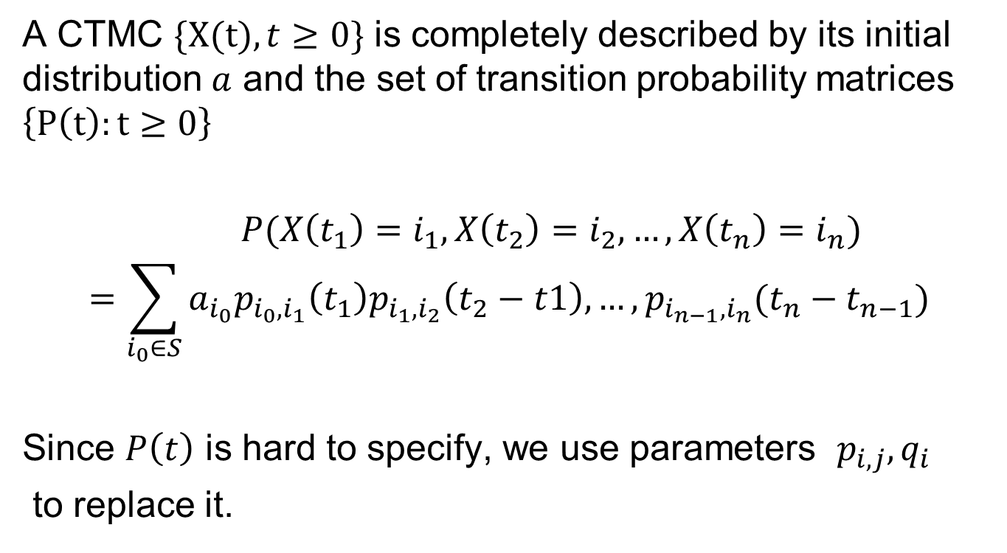
Joint Distribution
A CTMC $\{X(t), t≥0\}$ is completely described by its initial distribution $a$ and the set of transition probability matrices $\left\{P\left(t\right):t≥0\right\}$
$P(X\left(t_{1}\right)=i_{1},X\left(t_{2}\right)=i_{2},…,X\left(t_{n}\right)=i_{n})$
$$=\sum_{i_{0}∈S}{a_{i_{0}}p_{i_{0},i_{1}}\left(t_{1}\right)p_{i_{1},i_{2}}\left(t_{2}−t1\right),…,p_{i_{n−1},i_{n}}(t_{n}−t_{n−1})}$$
Since $P\left(t\right)$ is hard to specify, we use parameters $p_{i,j},q_{i}$
to replace it.

Slide 8
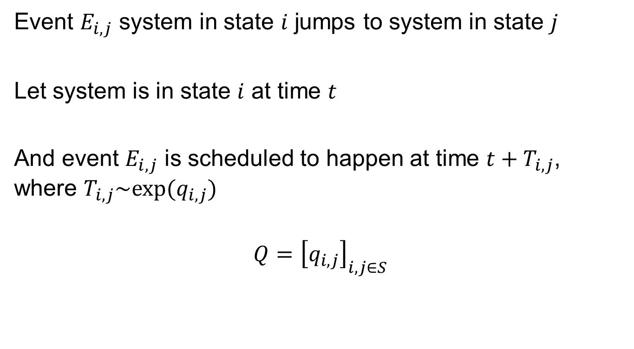
Generator Matrix Q
Event $E_{i,j}$ system in state $i$ jumps to system in state $j$
Let system is in state $i$ at time $t$
And event $E_{i,j}$ is scheduled to happen at time $t+T_{i,j}$, where $T_{i,j}\sim exp⁡(q_{i,j})$
$$Q={\left[q_{i,j}\right]}_{i,j∈S}$$
Next we will look into how to generate $Q$

Slide 9
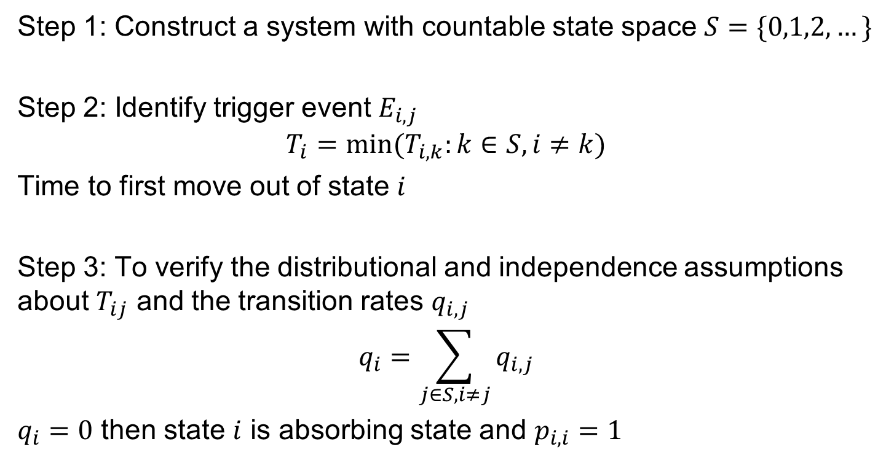
Generator Matrix Q
Step 1: Construct a system with countable state space $S=\{0,1,2,…\}$
Step 2: Identify trigger event $E_{i,j}$
$$T_{i}=min⁡(T_{i,k}:k∈S,i≠k)$$
Time to first move out of state $i$
Step 3: To verify the distributional and independence assumptions about $T_{ij}$ and the transition rates $q_{i,j}$
$$q_{i}=\sum_{j∈S, i≠j}{q_{i,j}}$$
$q_{i}=0$ then state $i$ is absorbing state and $p_{i,i}=1$

Slide 10

Q and Transition Probability
$$P\left(X_{n+1}=j,Y_{n+1}>y | X_{n}=i, Y_{n},X_{n−1},…,X_{1},Y_{1},X_{0}\right)$$
$$=P(X_{n+1}=j,Y_{n+1}>y|X_{n}=i)$$
$$=P(T_{i,j}=T_{i},T_{i}>y)$$
$$=\frac{q_{i,j}}{q_{i}}e^{−q_{i}y}$$
$$p_{i,j}=\frac{q_{i,j}}{q_{i}}$$

Slide 11


What is $q_{i,i}$?
$\{X\left(t\right),t≥0\}$ is a CTMC with parameters $q_{i}$ and $p_{i,j}, i,j∈S$
We define
$$q_{i,i}=−\sum_{j∈S, i≠j}{q_{i,j}}={−q}_{i}, i∈S$$
$$Q={\left[q_{i,j}\right]}_{i,j∈S}$$
What is the row sum of $Q$?

Slide 12
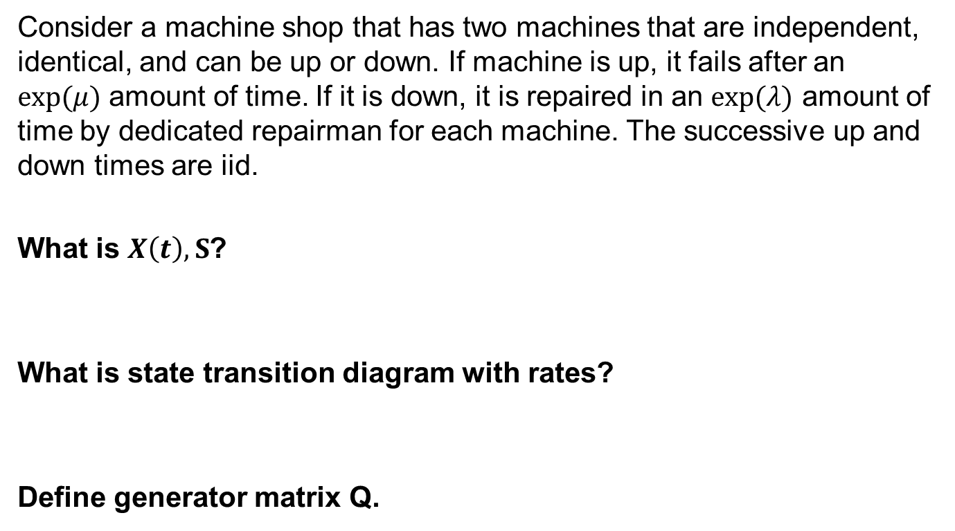
Machine Example 2
Consider a machine shop that has two machines that are independent, identical, and can be up or down. If machine is up, it fails after an $exp(μ)$ amount of time. If it is down, it is repaired in an $exp(λ)$ amount of time by dedicated repairman for each machine. The successive up and down times are iid.
What is $X\left(t\right),S$?
What is state transition diagram with rates?
Define generator matrix Q.

Slide 13

Machine Example 2 Modified
Define generator matrix Q.
What happens when there is only one repairman? How does transition diagram and $Q$ changes?

Slide 14
Pure Birth vs Death Process
Pure Birth Process
Pure Death Process

Slide 15
Stockbroker Example
A stockbroker is working on 3 portfolios: a, b, c. On average, he spends 1 week, 2 weeks and 1.5 weeks on a, b, c, respectively (exponentially distributed). When he finishes working a, he flips a coin to decide either b or c to work on. When he finishes working on b or c, he flips two coins. If he gets at least one head, then he will work on a. Otherwise, he will work on the other b or c.
Define a stochastic process based on this process as a CTMC.
Generate the Q and P matrices.

